Slide 1
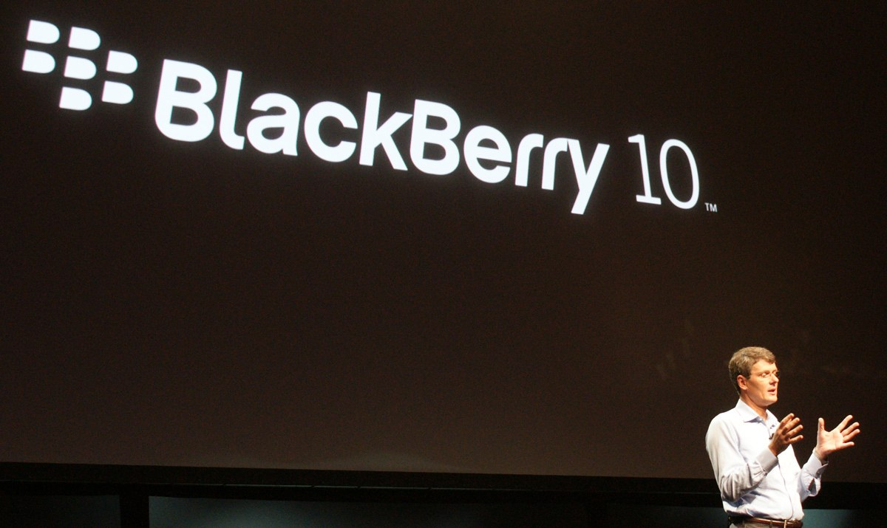
Save A Canadian Icon
Group 2

Slide 2
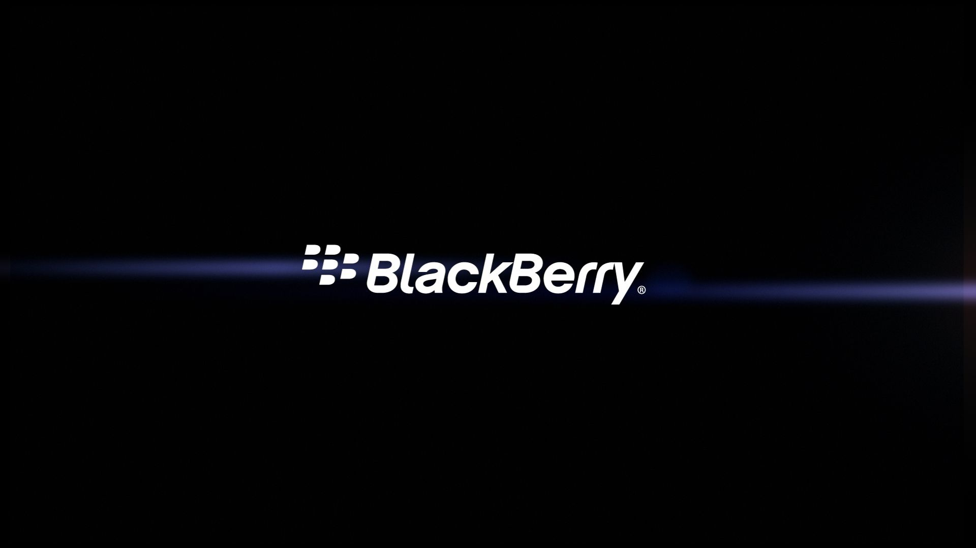

COMPANY RESEARCH

Slide 3

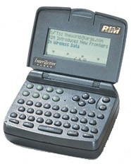
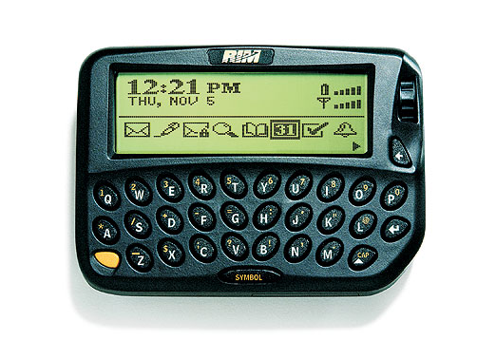
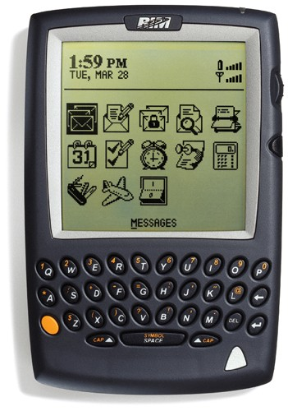
Early years and growth
Originally founded in 1984 as RIM(Research in Motion)
RIM became the first wireless data technology developer in North America
Introduced the DigiSync Film KeyKode Reader
Inter@ctive Pager, the first two-way messaging pager
BlackBerry 850 pager
BlackBerry 957

Slide 4
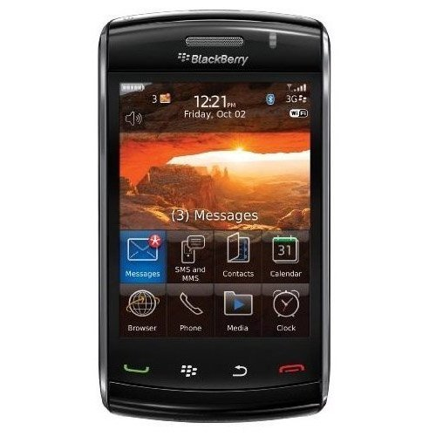
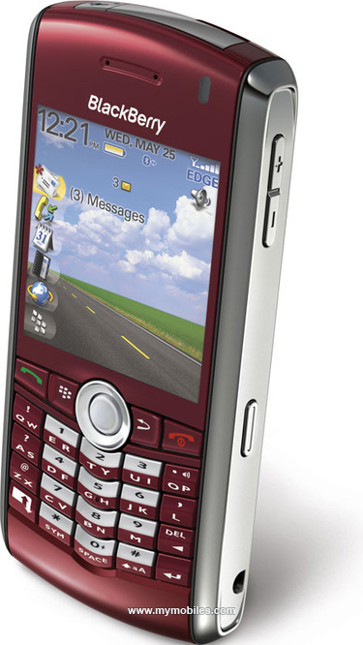
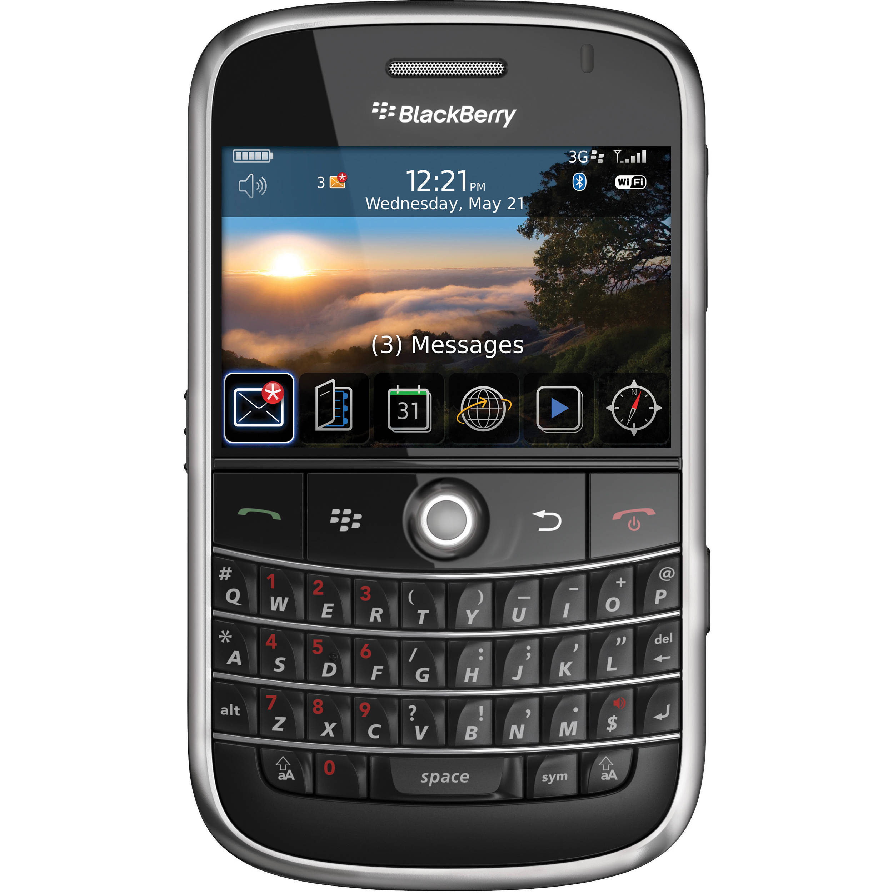
Global expansion and competition
RIM soon began to introduce BlackBerry devices aimed towards the consumer market as well
April 2007, Apple launched First Iphone
In US, 21 million users in the fall of 2010 and the company’s global subscribers stood at 36 million
Iphone, google accelerated growth in US
By Dec,2012 Blackberry had reached whopping 79
million subscribers all over the world
In January 2010, barely 3 million (7.1%) of the 42.7 million Smartphones in use in the US were running Android, to 18 mil BlackBerry devices (43%)
By February 2016, only 1.59 million (0.8%) of the 198.9 million smartphone users in the United States were running BlackBerry compared to 104.82 million (52.7%) running Android

Slide 5

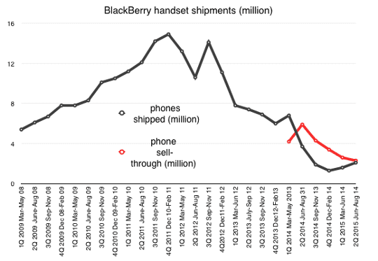
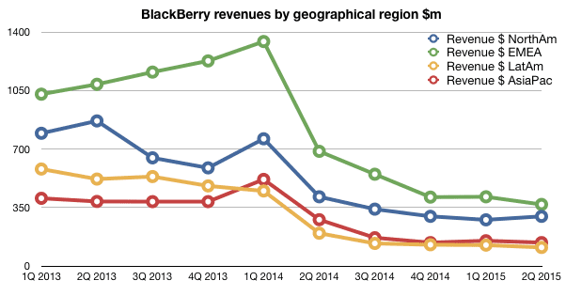
FINANCES

Slide 6
Transitions
Products Strategy
OS Transitions
Leadership
Acquisitions

Slide 7
Product : Hardware era
The Company RIM started as a hardware company with many innovative products.
In 1992, Mobitex and 1993 Mobitex Gateway.
In 1995, the Canadian government provided a 30 M Dollar investment and in 1996 it led to the inception of the iconic inter@activePager 900, the first two-way paging system hardware and software.
In 1998, the company made an Initial Public offering at the Toronto stock exchange and was soon competing with Motorola.
During fiscal 1999-2001, total assets declared in the RIM's balance sheet grew eight-fold due to massive capacity expansion.
In 2001, in the face of 9/11 catastrophe, RIM served as the leading secure telecommunications provider .

Slide 8
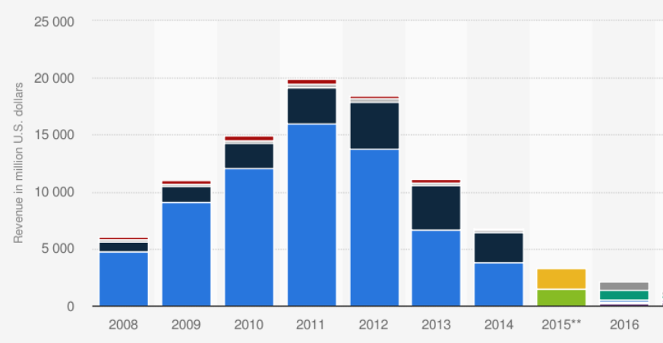
Mobile Era
By 2002, the company entered in Mobile industry.
In five years, RIM had acquired more than 30 percent of the smartphone market in America and second to Nokia globally.
However, the company failed to follow the pace of touchscreen and application platform of Apple and Google Android, two companies that RIM didn’t view as competitors.

Slide 9
Modern Approach
Blackberry Reformed itself from a Hardware company to Software Company with Systems security as the leading service.
The company has made a brand name In Security with more than three thousand patents and 80 certifications.
The company has invested in research centers and development that not only allow the company to be at par with present technology but also aim to focus on future breakthroughs that will help the company gain transient advantages and be head and shoulders ahead of its competitors.
The company has also invested in IoT and Automotive Software.

Slide 10
Operating System Transitions
Java based OS
This OS served very well for the low-powered devices and high security enterprises. However, as the needs of the mobile user changed the OS failed to adapt to mobile web-browsing, multimedia and touch Screen interfaces.
To overcome, they aimed to tackle by building a new platform.
QNX platform
Launched in April 2011. Platform for BlackBerry tablet in order to compete with Apple iPad. Criticized however for having software errors, bad application selections and lack of native email, calendar and contacts.
Blackberry Leap is the latest and updated state of the art OS built on QNX.
Android
In order to focus on quicker revenue generation simultaneously the company made strategic partnerships with existing OS manufactures and launched first Android phone in 2015. BlackBerry android is almost stock android with tweaks to improve productivity. BlackBerry Pirv was their most successful keyboard-slider phone.

Slide 11
Leadership Transitions
The company had a dual- CEO structure wherein Mike Lazaridis oversaw technical functions whereas Jim Balsillie oversaw sales and marketing.
It was touted by many as dysfunctional management structure and believed RIM acted as two companies.
There were several rifts amongst the top hierarchy and the strain in relations reached their lowest in 2010. The surging sales caused heavy burden on manufacturing and that manifested itself in poor product quality. There was a complete breakdown of comminutions between the two CEO's and their reporting departments
In 2012, RIM changed its management to a single executive with Thorsten Heins chosen as their successor. He made significant changes by binging in experts from different domains. He changed the focus of Blackberry from building products for everyone to building products with their prowess.
Late in 2013, John S. chen took over the reigns from thorsten . He is endorsed as 'Turnaround CEO'. He changed the organization's focus to service and software.

Slide 12
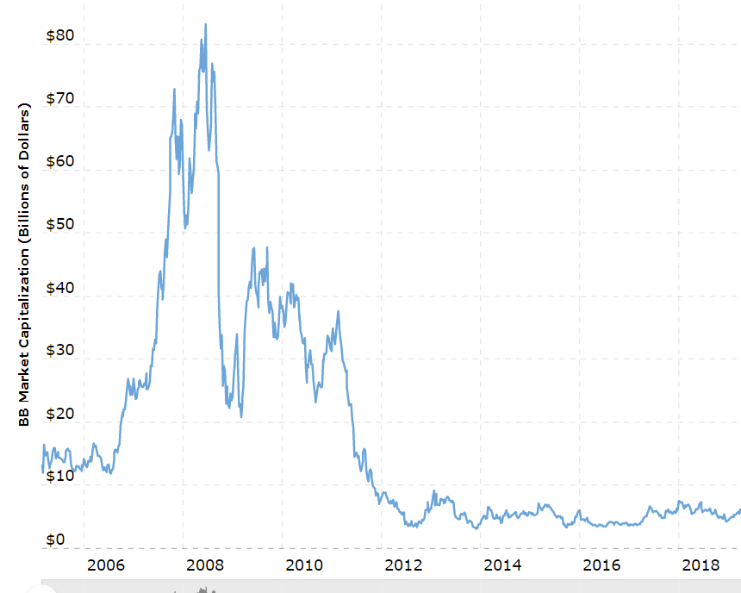
Market Cap
Market capitalization refers to the total dollar market value of a company's shares.
Calculated by multiplying a company's shares outstanding by the current market price of one share.
The investment community uses this figure to determine a company's size, as opposed to sales figures.

Slide 13
Acquisitions
Through the years, particularly as the company evolved towards its new platform, BlackBerry has made numerous acquisitions of third-party companies and technology.
Certicom
A cryptography company that includes over 350 patents. And boasts a clientele involving Motorola, Oracle and General Dynamics.
DataViz
They bought their office suite 'Documents to go' which allowed blackberry users to edit Microsoft documents on their phones.
QNX
They acquired the QNX software systems in 2010. It was done to serve as the foundation for the next generation blackberry platforms.
During 2015, BlackBerry also expanded its software and services offerings with several key acquisitions. These included file security firm WatchDox, crisis communications leader AtHoc, and rival EMM vendor Good Technology. The products offered by these firms were gradually re-branded and integrated into BlackBerry's own portfolio. In 2016, the company tied these services along with existing software's and sold as a bundle.

Slide 14
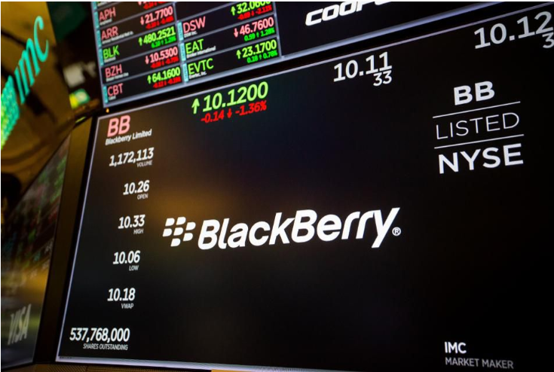
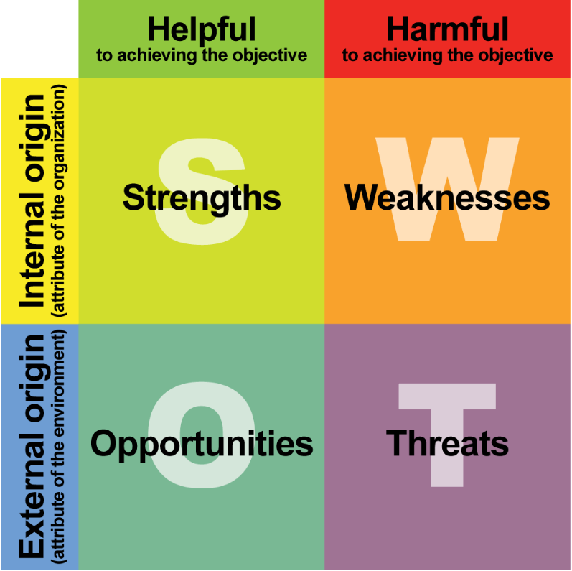
SWOT ANALYSIS

Slide 15



SWOT ANALYSIS
Strengths
Security Technology
Blackberry owns 37500 patents in Security Technology.
Enhancing the cryptography tool arsenal, Company added a Quantum-resistant code signing server in Oct 2018.
It holds 80+ renowned security certifications, even approved by NATO and various defense industries

Slide 16

SWOT ANALYSIS
Strengths
Global Reputation for Security
Company became the device provider of US since the 9/11 attack.
It serves all G7 governments, largest commercial banks and insurance companies, largest healthcare and aerospace/defense companies.
BB10 smartphone approved by US Department of Defense.

Slide 17

SWOT ANALYSIS
Strengths
Operational Advantage
Blackberry has successfully shifted from hardware company to a software company, reshaping its revenue structure.
In 2016-18, the percentage of software revenue grew from 24% to 81%
The operating margin of the whole company grew from -5% to 8%

Slide 18

SWOT ANALYSIS
Strengths
Innovation and Transient Advantage
Blackberry invests 23% of total revenue into R&D.
It holds 18 major development centers in 7 countries, ensuring systematic process of innovation and new profitable opportunities.
Constantly developing transient advantage over the rivals, the company even made rapid acquisitions of its biggest rivals, the ‘Good Technology’.

Slide 19


SWOT ANALYSIS
Strengths
Experience in Hardware Development
Former glory of Smartphones, pagers and Operating systems led Blackberry to own a mature process in developing automatic vehicles & related operating systems. Thus, strengthening the current IOT industry solutions.
Leadership Advantage
The new CEO John Chen made the company profitable again.
John Chen made several aggressive and effective decisions to save the company, including outsourcing all the manufacturing to partners and visiting the White House to keep on building the reputation of security.

Slide 20


SWOT ANALYSIS
Weaknesses
Small Smartphone Market Share
Difficult to compete with latest smartphones after losing once the market share to the brands - Apple, Samsung and Google Android.
Cash Flow
The smartphones market share and revenue are shrinking gradually.
Thus, no short term ROI.
Long-term intensive R&D getting difficult due to current stringent financial condition.

Slide 21

SWOT ANALYSIS
Weaknesses
Customized Enterprise Operating System
Blackberry offers enterprises with secure and complicated operating systems as IOT solutions.
However, the customizing and integrating took a considerably long time and great effort.
The IOT technology product line delayed the turnaround instead of achieving the required short-term ROI.

Slide 22

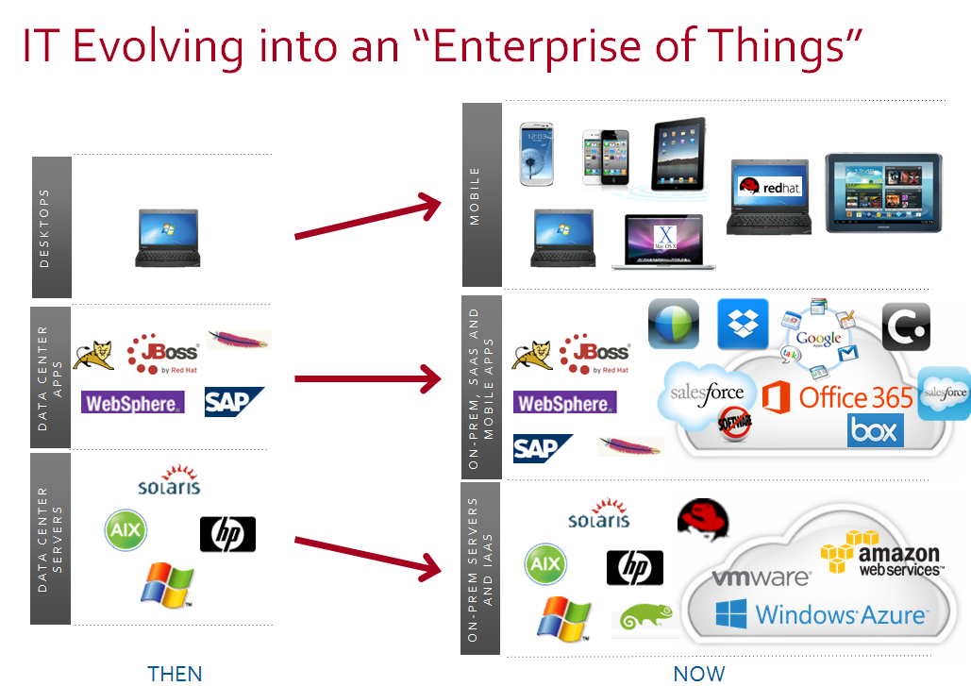

SWOT ANALYSIS
Opportunities
Promising Market in EOT
Market Prospect of Enterprise of Things is promising and bright.
EOT Enables digital transformation using Hyper-Connected “things” that are secure.
EOT market is expected to grow ten times in the upcoming 5-10 years.
Barriers to EOT success is “security” which is key aspect of blackberry.
Blackberry already shifted focus to EOT.
IOT platforms already available are not close to an industry standards and market is open for innovation.
Physical
Things
Digital

Slide 23
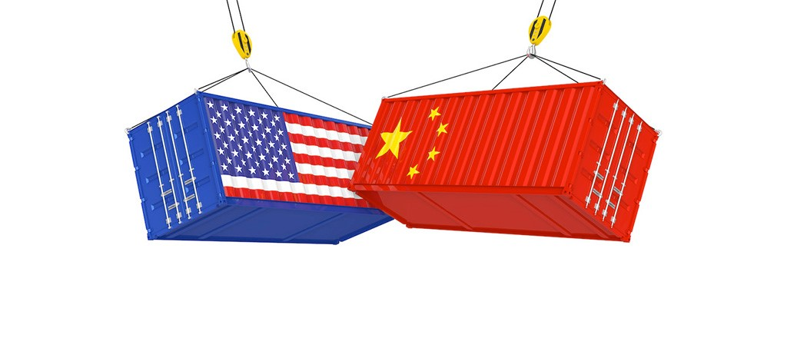
SWOT ANALYSIS
Opportunities
Economic Conflicts-Trade War and HUAWEI Ban
US –China trade war due to imposed taxes on Chinese goods by US in order to make people buy American.
Huawei was banned in US as it had good connections with Chinese government.
It was feared that the equipment could be used to spy on other countries and companies.
Raised the concern of cyber security, which can be beneficial to reputed Blackberry Ltd.

Slide 24

SWOT ANALYSIS
Opportunities
Privacy Leakage and Barriers to IOT
Constant news and articles about leakage of personal information, which arouse huge concerns to the internet and IOT industry.
Popular social medias like Facebook and large finance organizations like Desjardins were reported to leak personal data recently.
Recent news about the Capital One data hack where the personal information about the customers including the Personal information and credit card details were compromised.
The fear to privacy leakage has become a significant barrier to IOT and other internet-related industries especially in individual consumer market.
The preference of governments on local enterprises can help with the growth and development of Blackberry.

Slide 25

SWOT ANALYSIS
Threats
Security Centers of Internet Giants
Large enterprises including Google, Microsoft and Alibaba have their own security centers and can be strong competitors of Blackberry.
There are also well-known enterprise software companies occupying huge amount of market share.

Slide 26

SWOT ANALYSIS
Threats
IOT Platforms and Producers
There are tons of large companies and startups investing in IOT technology in different fields.
Moreover, some of these industries are both hardware and software manufacturers.
The accumulated experience and knowledge in automatic vehicle industry can help Blackberry compete with others.
However, those with mature product lines are big threats to the diffusion of Blackberry IOT platform.

Slide 27
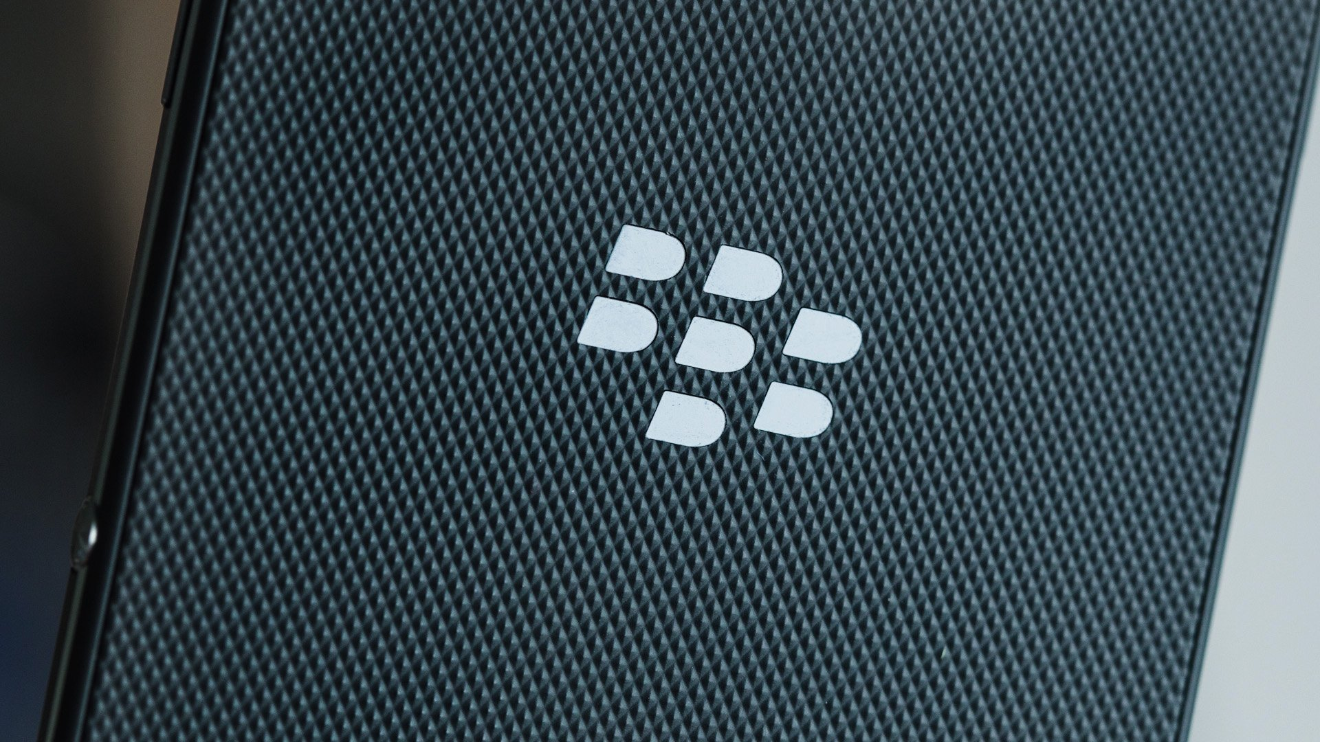
Strategy Analysis - Strategy Statement
What will we do?
We suggest Blackberry to march into individual consumer market of IOT.
How will we do it?
A systematic process can be developed to provide consumer level services and products.
Why are we doing it?
Due to the availability of scalable technology which has a great potential to expand into more profitable market, thus, building the brand reputation simultaneously.
Combined Strategy Statement
We suggest Blackberry to develop a systematic process to provide consumer level services and products to march into individual consumer market of IOT, in order to expand into more profitable market and build the brand reputation.
MARCH INTO
CONSUMER LEVEL IOT MARKET

Slide 28
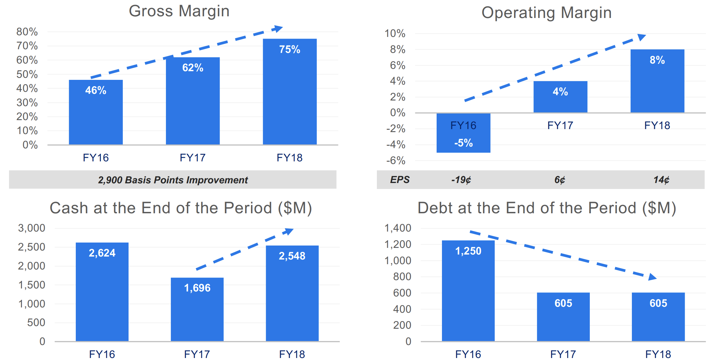
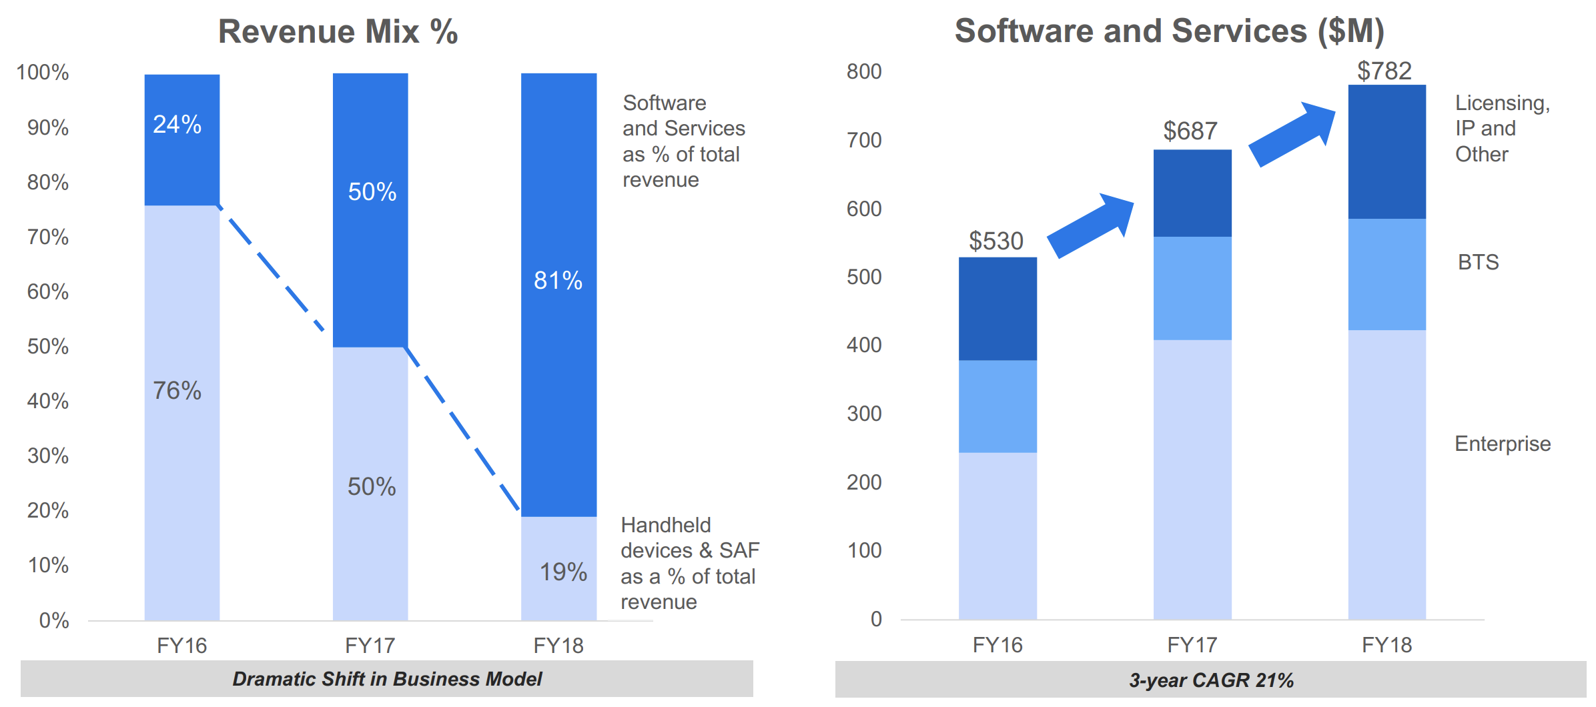
Strategy Analysis – Current Focus
BB Strategic Overview from Analyst Day

Slide 29
Strategy Analysis – Potential Market
Ericcson’s Prediction of IOT Market
Bain’s Prediction of IOT Market

Slide 30
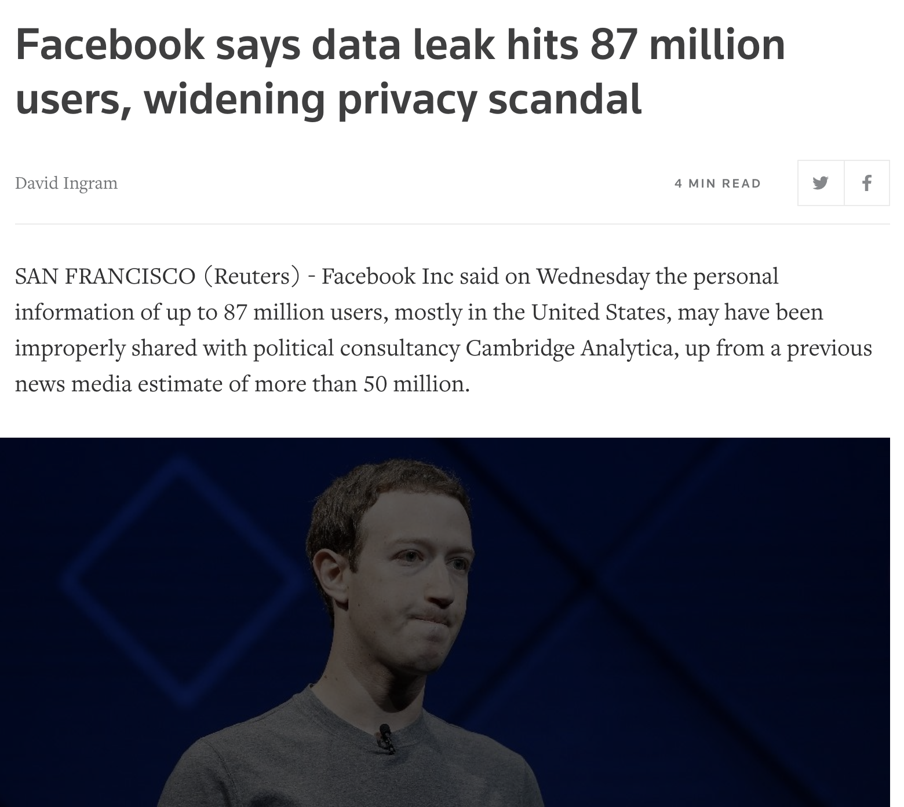
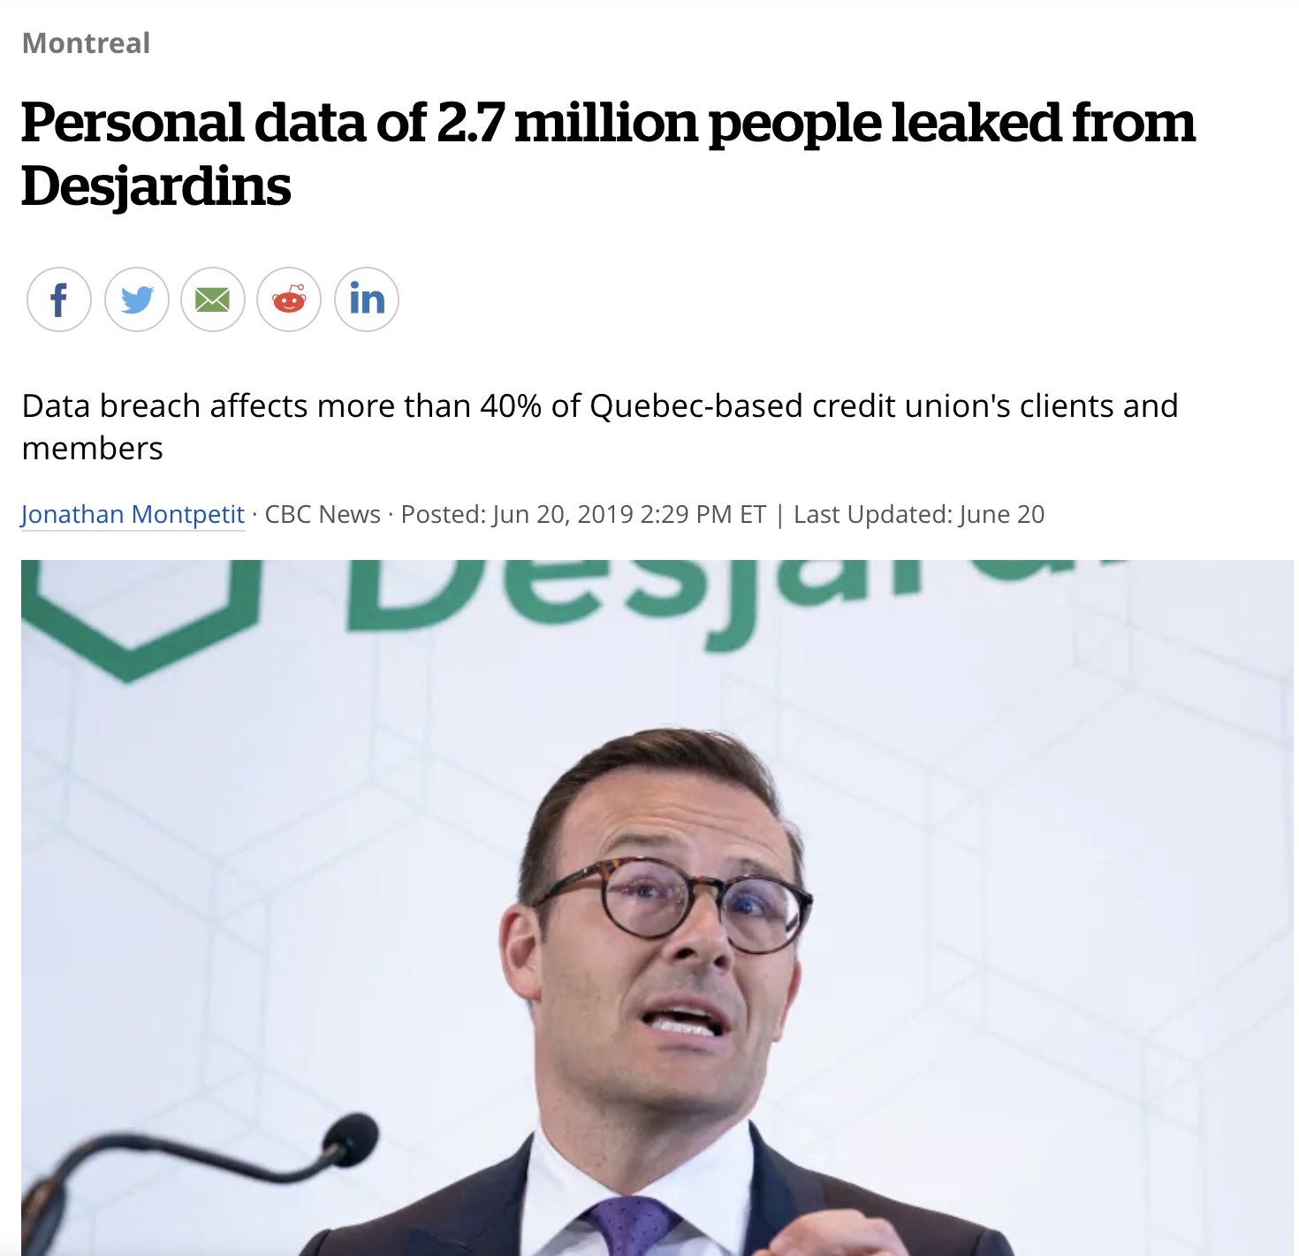
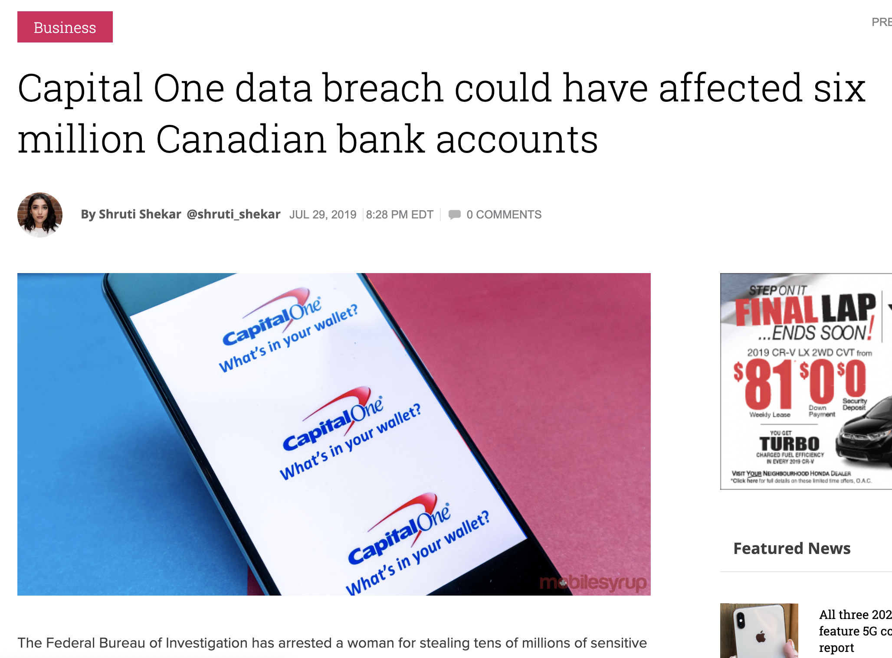
Strategy Analysis – Potential Market
Individual Customer’s Awareness
Barrier to IOT Adoption
Emergent Need for Cyber Security

Slide 31
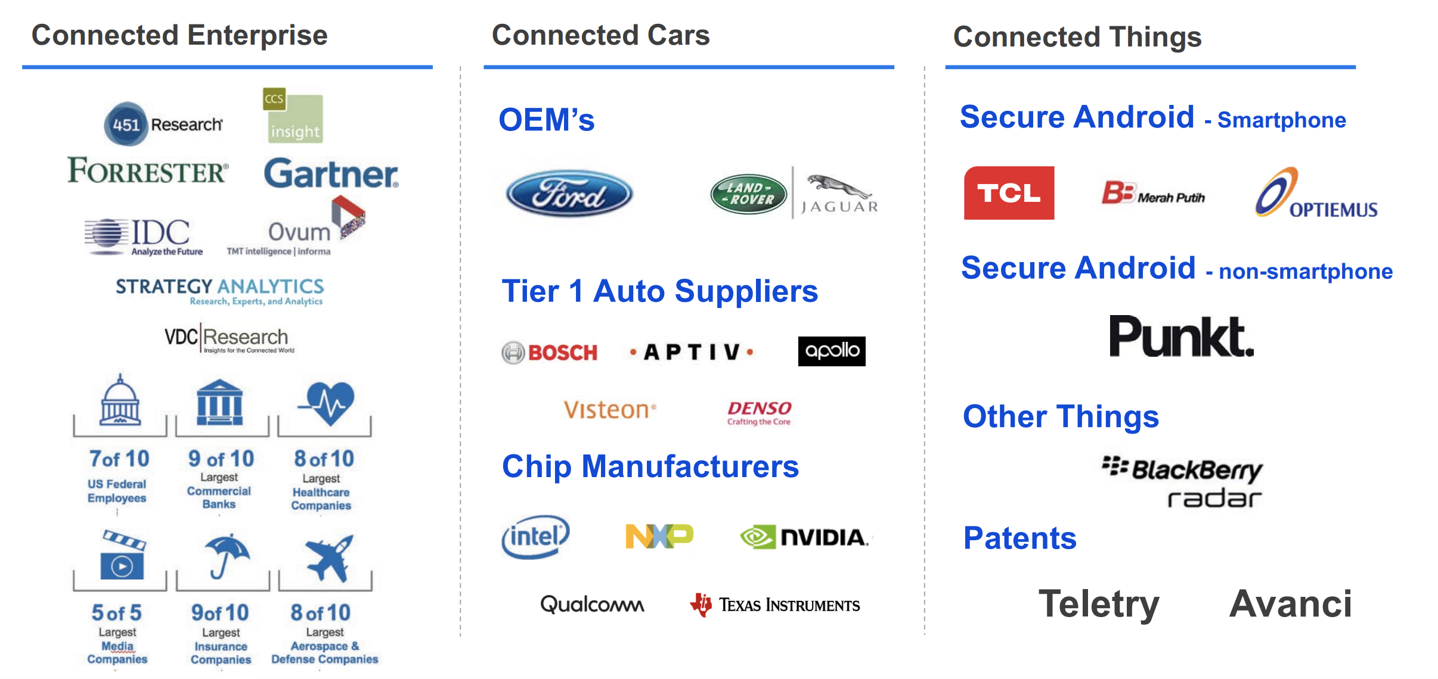
Strategy Analysis – Competitive Advantage
20 Year’s Security Technology Development
Experience in Individual Customer Device
Great Reputation in Security Technology for Decades
BB Strategic Overview from Analyst Day

Slide 32
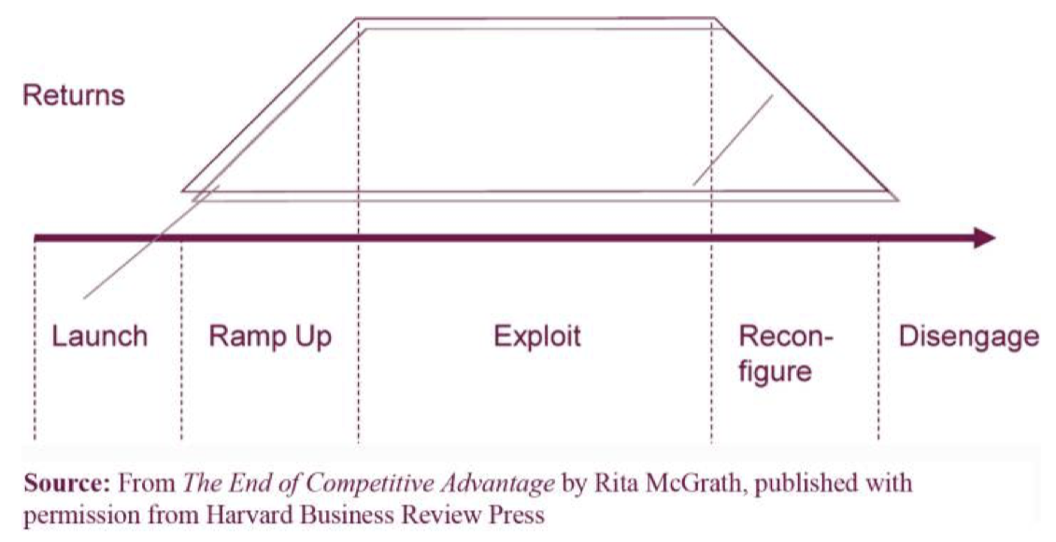
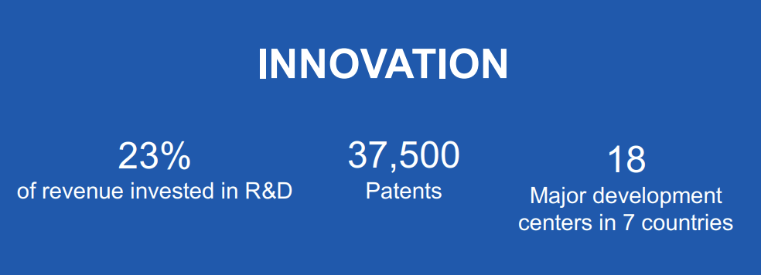
Strategy Analysis – Organizational Strategy
Shifting The Product Line
From Smartphones to IOT Consumer Level Devices
Expand The Alignment
Cooperate with More Companies Especially Hardware Ones and Set Up the Industry Standard
March into Oversea Market
Especially the Market of North Asia
Develop Another Operating System
Deal with Volatile Consumer Market
BB Strategic Overview from Analyst Day

Slide 33
Strategy Analysis – Potential Functional Strategy
Wearable Devices
License and Optional Service
IOT Platform

Slide 34
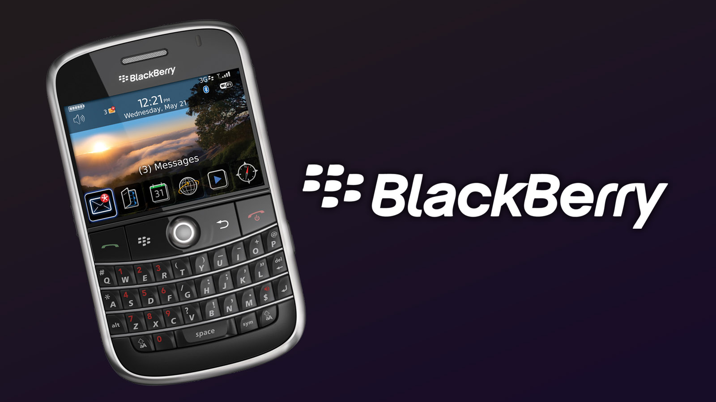
Thank You!

